Slide 1




Formal XAI via Syntax-Guided Synthesis
Katrine Bjørner, Samuel Judson, Filip Cano,
Drew Goldman, Nick Shoemaker,
Ruzica Piskac and Bettina Könighofer
24 October 2023
This work has received funding from the European Union’s Horizon 2020 research and innovation programme under grant agreement Nº 956123 - FOCETA.
Notes:
Safety of autonomous agents in real-world
One aspect often overlooked
Unexpected safety violations

Slide 2

Bridging the Gap between AI and Reality
Formal XAI via Syntax-Guided Synthesis Katrine Bjørner, Filip Cano
Explanations are a fundamental part of the bridge!
📖 Mnih et al., Explainable artificial intelligence: a comprehensive review, Artificial Intelligence Review, 2022

Slide 3
Explainable AI with Formal Guarantees
Formal XAI via Syntax-Guided Synthesis Katrine Bjørner, Filip Cano
Explanations are fundamental for trustworthiness
How can you trust an explanation?
One popular way is to produce a simplified surrogate model that behaves like the more complex model
Surrogates based on statistical optimization have asymptotic correctness guarantees 📖
Formal methods can provide formal guarantees!
📖 Ribeiro, Singh & Guestrin, ”Why should I trust you?” Explaining predictions to any classifier, KDD, 2016
📖 Lundberg & Lee, A unified approach to interpreting model predictions, NeurIPS, 2017

Slide 4


Global vs Local Explanations
Formal XAI via Syntax-Guided Synthesis Katrine Bjørner, Filip Cano
Explanatory surrogate models can be local or global
Global
Local
Notes:
To do: global vs local explanation in an image

Slide 5
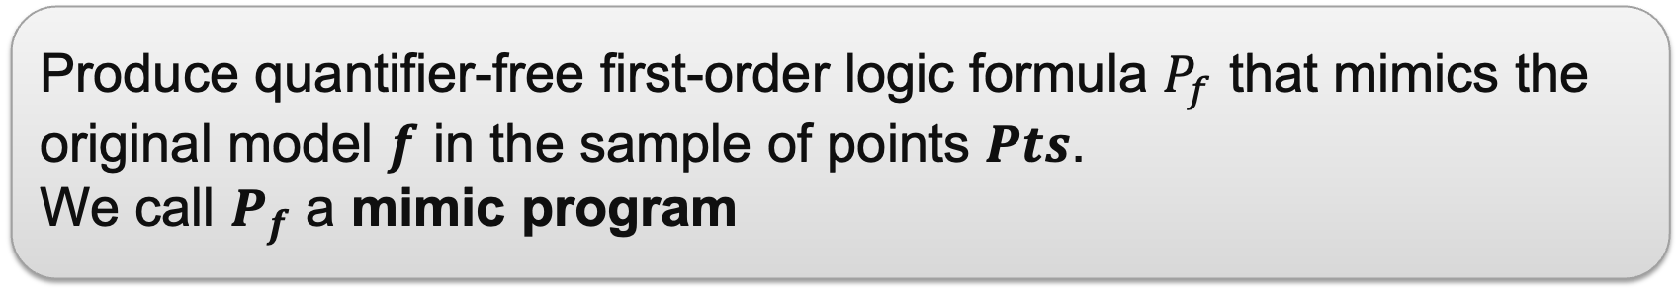
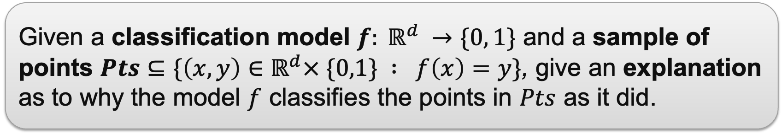
Explain a Classfication Model‘s Decision
Formal XAI via Syntax-Guided Synthesis Katrine Bjørner, Filip Cano
Problem statement
Given a classification model $f: ℝ^{d} →\{0, 1\}$ and a sample of points $Pts⊆\{\left(x,y\right)∈$ $ℝ^{d}× \{0,1\} : f\left(x\right)=y\}$, give an explanation as to why the model $f$ classifies the points in $Pts$ as it did.
Proposed solution
Produce quantifier-free first-order logic formula $P_{f}$ that mimics the original model $f$ in the sample of points $Pts$.
We call $P_{f}$ a mimic program

Slide 6
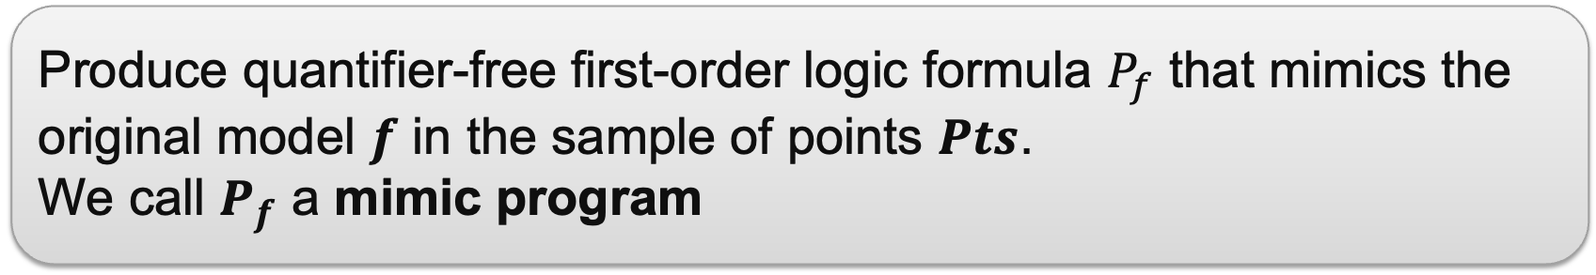
Our Method: Synthesize Mimic Programs
Formal XAI via Syntax-Guided Synthesis Katrine Bjørner, Filip Cano
Produce quantifier-free first-order logic formula $P_{f}$ that mimics the original model $f$ in the sample of points $Pts$.
We call $P_{f}$ a mimic program
First order logic formulas are
Human friendly: easy to interpret for small enough formulas
Machine friendly: easy to implement as computer programs
📖 Alur et al., Syntax-Guided Synthesis, FMCAD, 2013

Slide 7
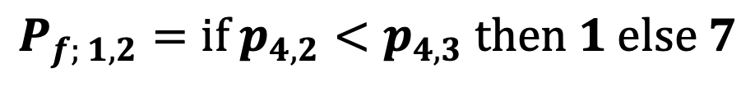
Illustrative Example
Formal XAI via Syntax-Guided Synthesis Katrine Bjørner, Filip Cano
$$P_{f; 1,2}=if p_{4,2}<p_{4,3} then 1 else 7$$
$P_{f; 1−3}=if {(p}_{4,2}<p_{4,3}$∨ $p_{4,2}< p_{4,4}) then 1 else 7$
Notes:
To do :
- Animate this slide
- Add the alternative P_1-3

Slide 8
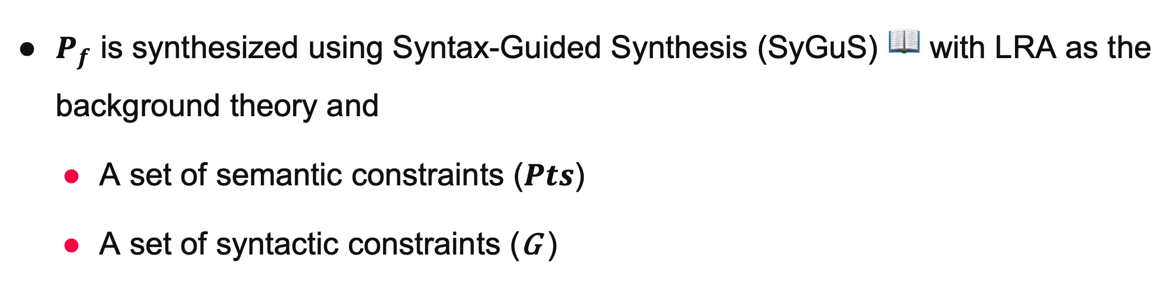
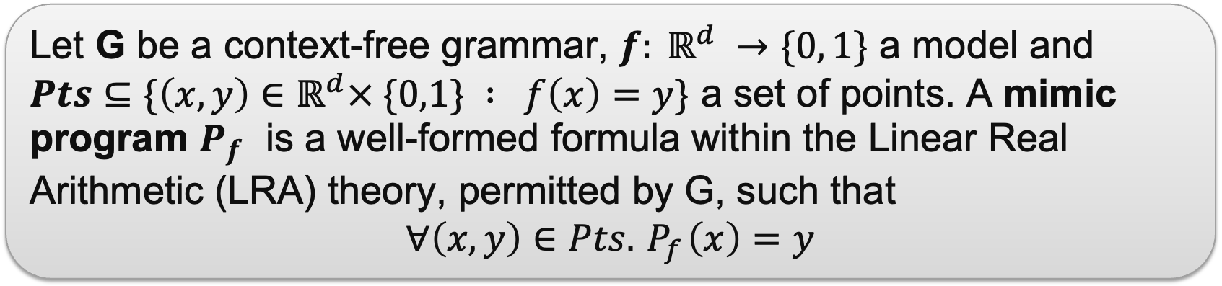
Mimic Programs: Definition & Synthesis
Formal XAI via Syntax-Guided Synthesis Katrine Bjørner, Filip Cano
Definition
Let G be a context-free grammar, $f: ℝ^{d} →\{0, 1\}$ a model and $Pts⊆\{\left(x,y\right)∈$ $ℝ^{d}× \{0,1\} : f\left(x\right)=y\}$ a set of points. A mimic program $P_{f}$ is a well-formed formula within the Linear Real Arithmetic (LRA) theory, permitted by G, such that
$$∀\left(x,y\right)∈Pts.{ P}_{f}\left(x\right)=y$$
$P_{f}$ is synthesized using Syntax-Guided Synthesis (SyGuS) 📖 with LRA as the background theory and
A set of semantic constraints ($Pts$)
A set of syntactic constraints (G )
📖 Alur et al., Syntax-Guided Synthesis, FMCAD, 2013

Slide 9
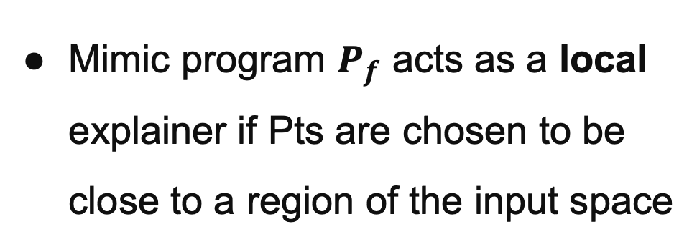

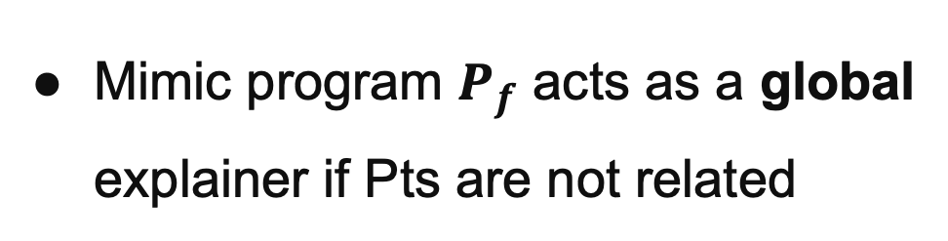
Semantic Constraints
Formal XAI via Syntax-Guided Synthesis Katrine Bjørner, Filip Cano
Semantic constraints: $Pts⊆\{\left(x,y\right)∈$ $ℝ^{d}× \{0,1\} : f\left(x\right)=y\}$
Mimic program $P_{f}$ acts as a global explainer if Pts are not related
Mimic program $P_{f}$ acts as a local explainer if Pts are chosen to be close to a region of the input space

Slide 10
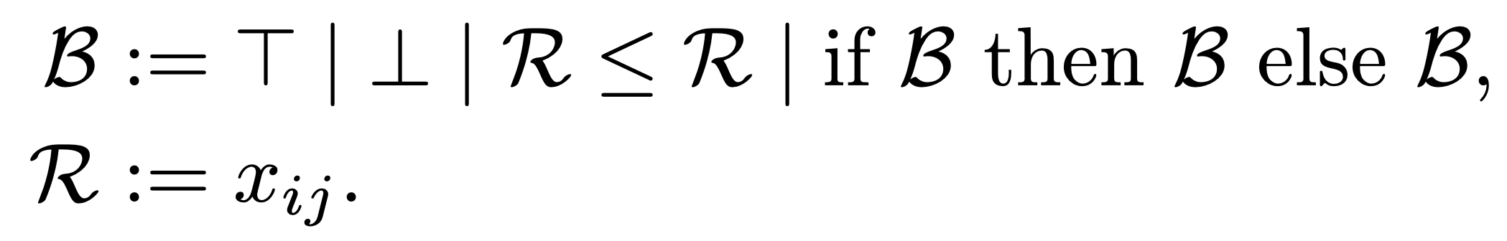
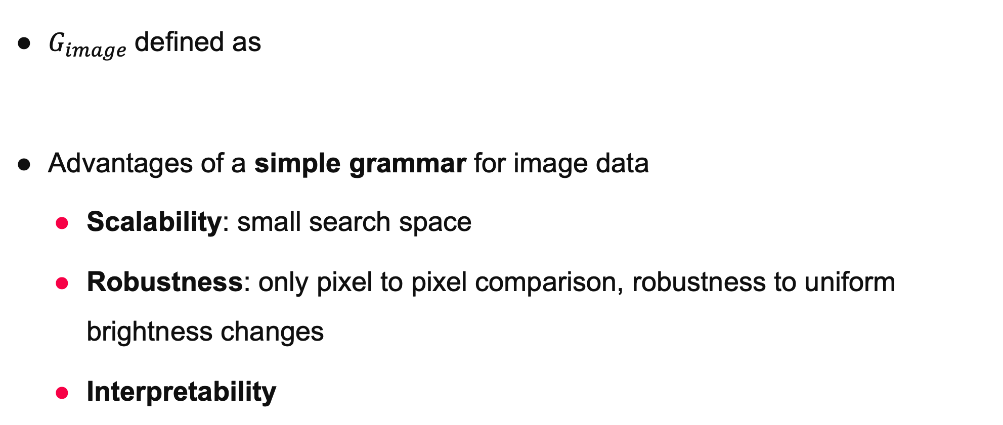
Syntactic Constraints: Image Data
Formal XAI via Syntax-Guided Synthesis Katrine Bjørner, Filip Cano
$G_{image}$defined as
Advantages of a simple grammar for image data
Scalability: small search space
Robustness: only pixel to pixel comparison, robustness to uniform brightness changes
Interpretability

Slide 11
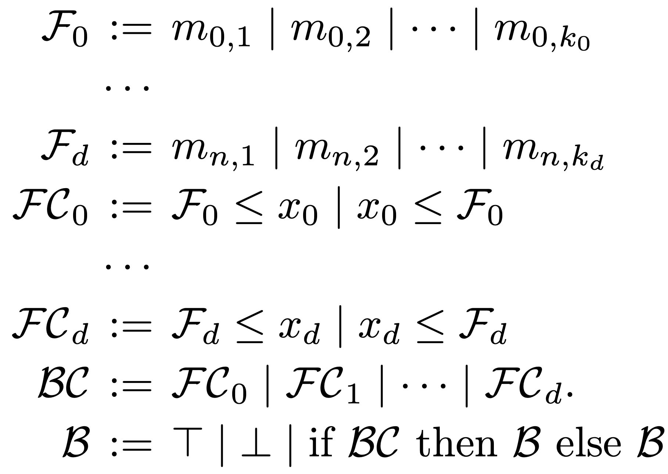
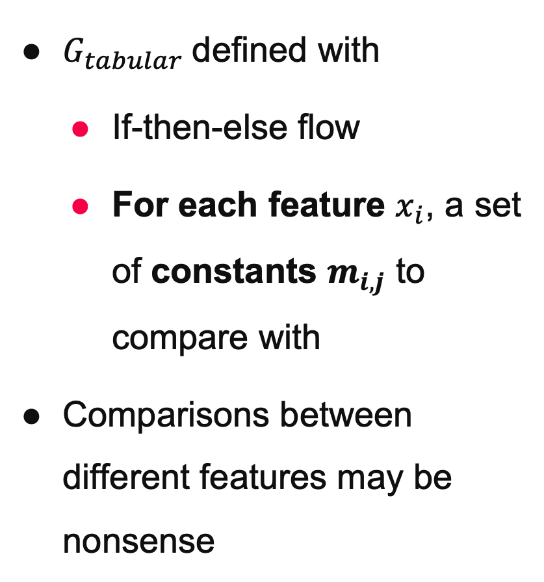
Syntactic Constraints: Tabular Data
Formal XAI via Syntax-Guided Synthesis Katrine Bjørner, Filip Cano
$G_{tabular}$defined with
If-then-else flow
For each feature $x_{i}$, a set of constants $m_{i,j}$ to compare with
Comparisons between different features may be nonsense

Slide 12
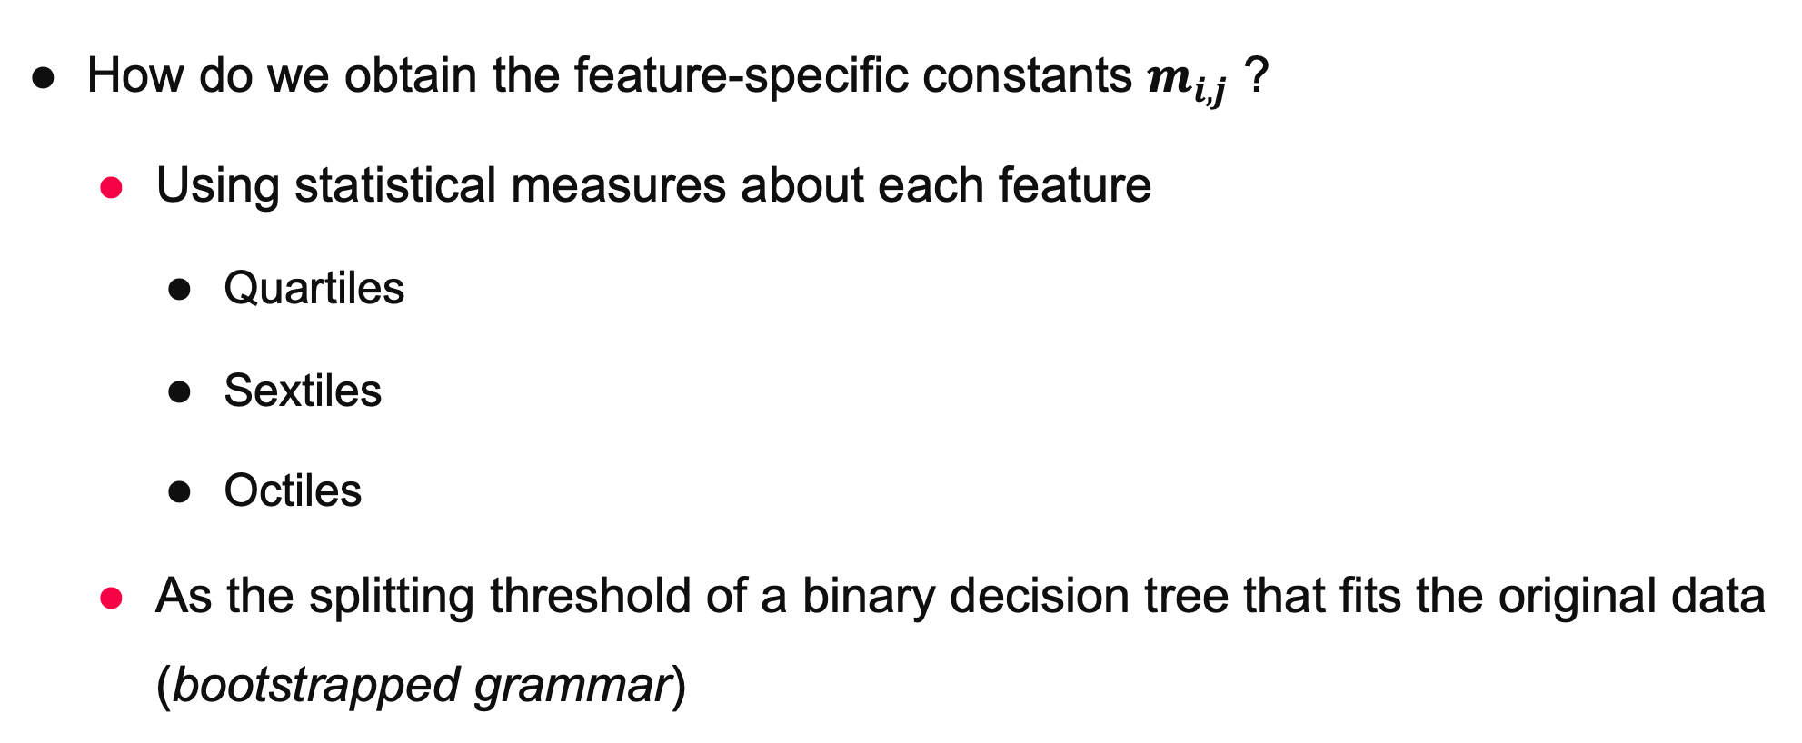
Syntactic Constraints: Tabular Data
Formal XAI via Syntax-Guided Synthesis Filip Cano
How do we obtain the feature-specific constants $m_{i,j}$ ?
Using statistical measures about each feature
Quartiles
Sextiles
Octiles
As the splitting threshold of a binary decision tree that fits the original data (bootstrapped grammar)

Slide 13
Experimental Evaluation
Formal XAI via Syntax-Guided Synthesis Katrine Bjørner, Filip Cano
Two (2) datasets
MNIST: Image data
Standard dataset, easy to learn, high accuracy
Pima diabetes: Tabular data
Higher complexity, typical classification, ≤ 80% accuracy
Questions:
Synthesis times
Interpretability (size and depth of programs)
Accuracy

Slide 14
Experimental Evaluation
Formal XAI via Syntax-Guided Synthesis Katrine Bjørner, Filip Cano
Decision Trees (DT)
Baseline comparison for synthesis times, interpretability, and accuracy
scikit-learn

Slide 15
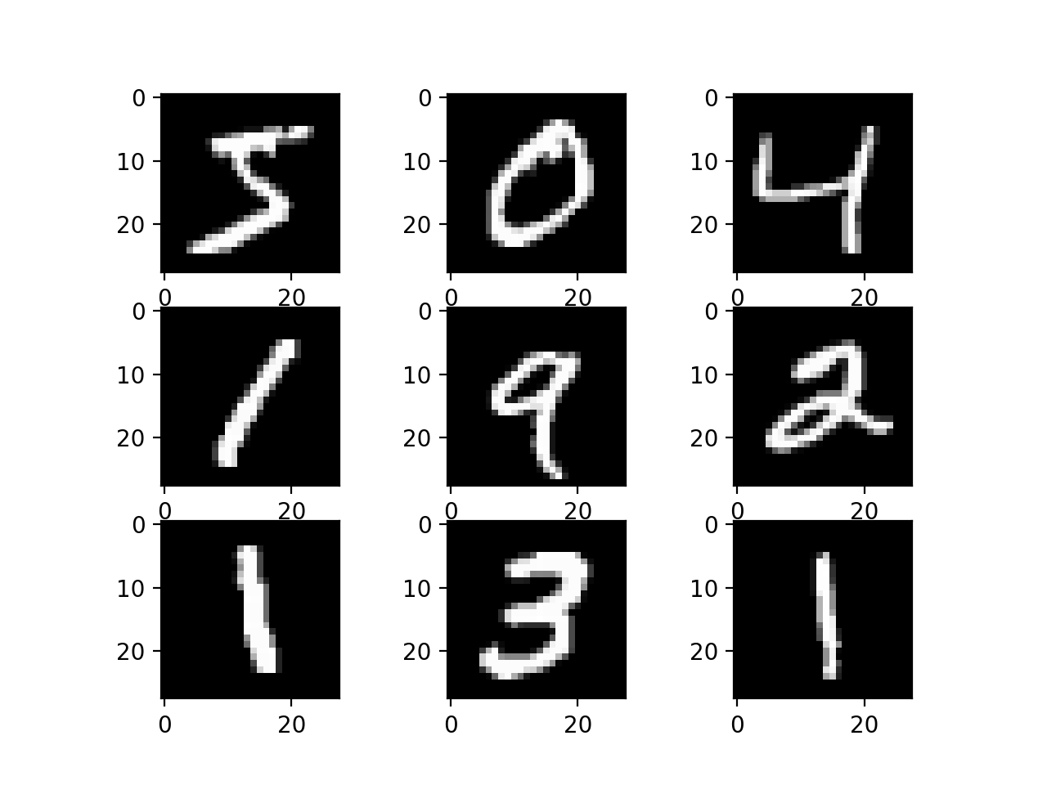
The MNIST Dataset
Formal XAI via Syntax-Guided Synthesis Katrine Bjørner, Filip Cano
Handwritten digits
28x28 pixels each
60k samples
Simple neural network reaches ~99% accuracy

Slide 16
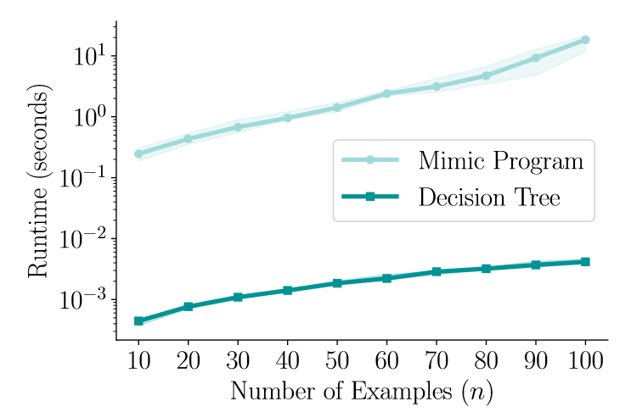
MNIST – Synthesis Times
Formal XAI via Syntax-Guided Synthesis Katrine Bjørner, Filip Cano

Slide 17
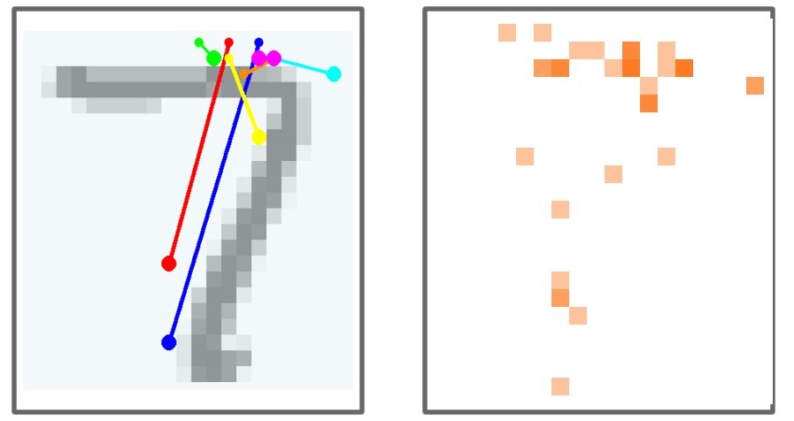
MNIST – Characteristics
Formal XAI via Syntax-Guided Synthesis Katrine Bjørner, Filip Cano
comparisons of pixels from the resulting decision tree overlapping an interpretation of an MNIST image using its greyscale values
heat map: how many times the pixel appears in the resulting decision tree

Slide 18

MNIST – Interpretability
Formal XAI via Syntax-Guided Synthesis Katrine Bjørner, Filip Cano
Measured by:
program size: number of If-Else
statements
program depth: max depth of
nested If-Else statements
Mimic programs smaller than DTs

Slide 19
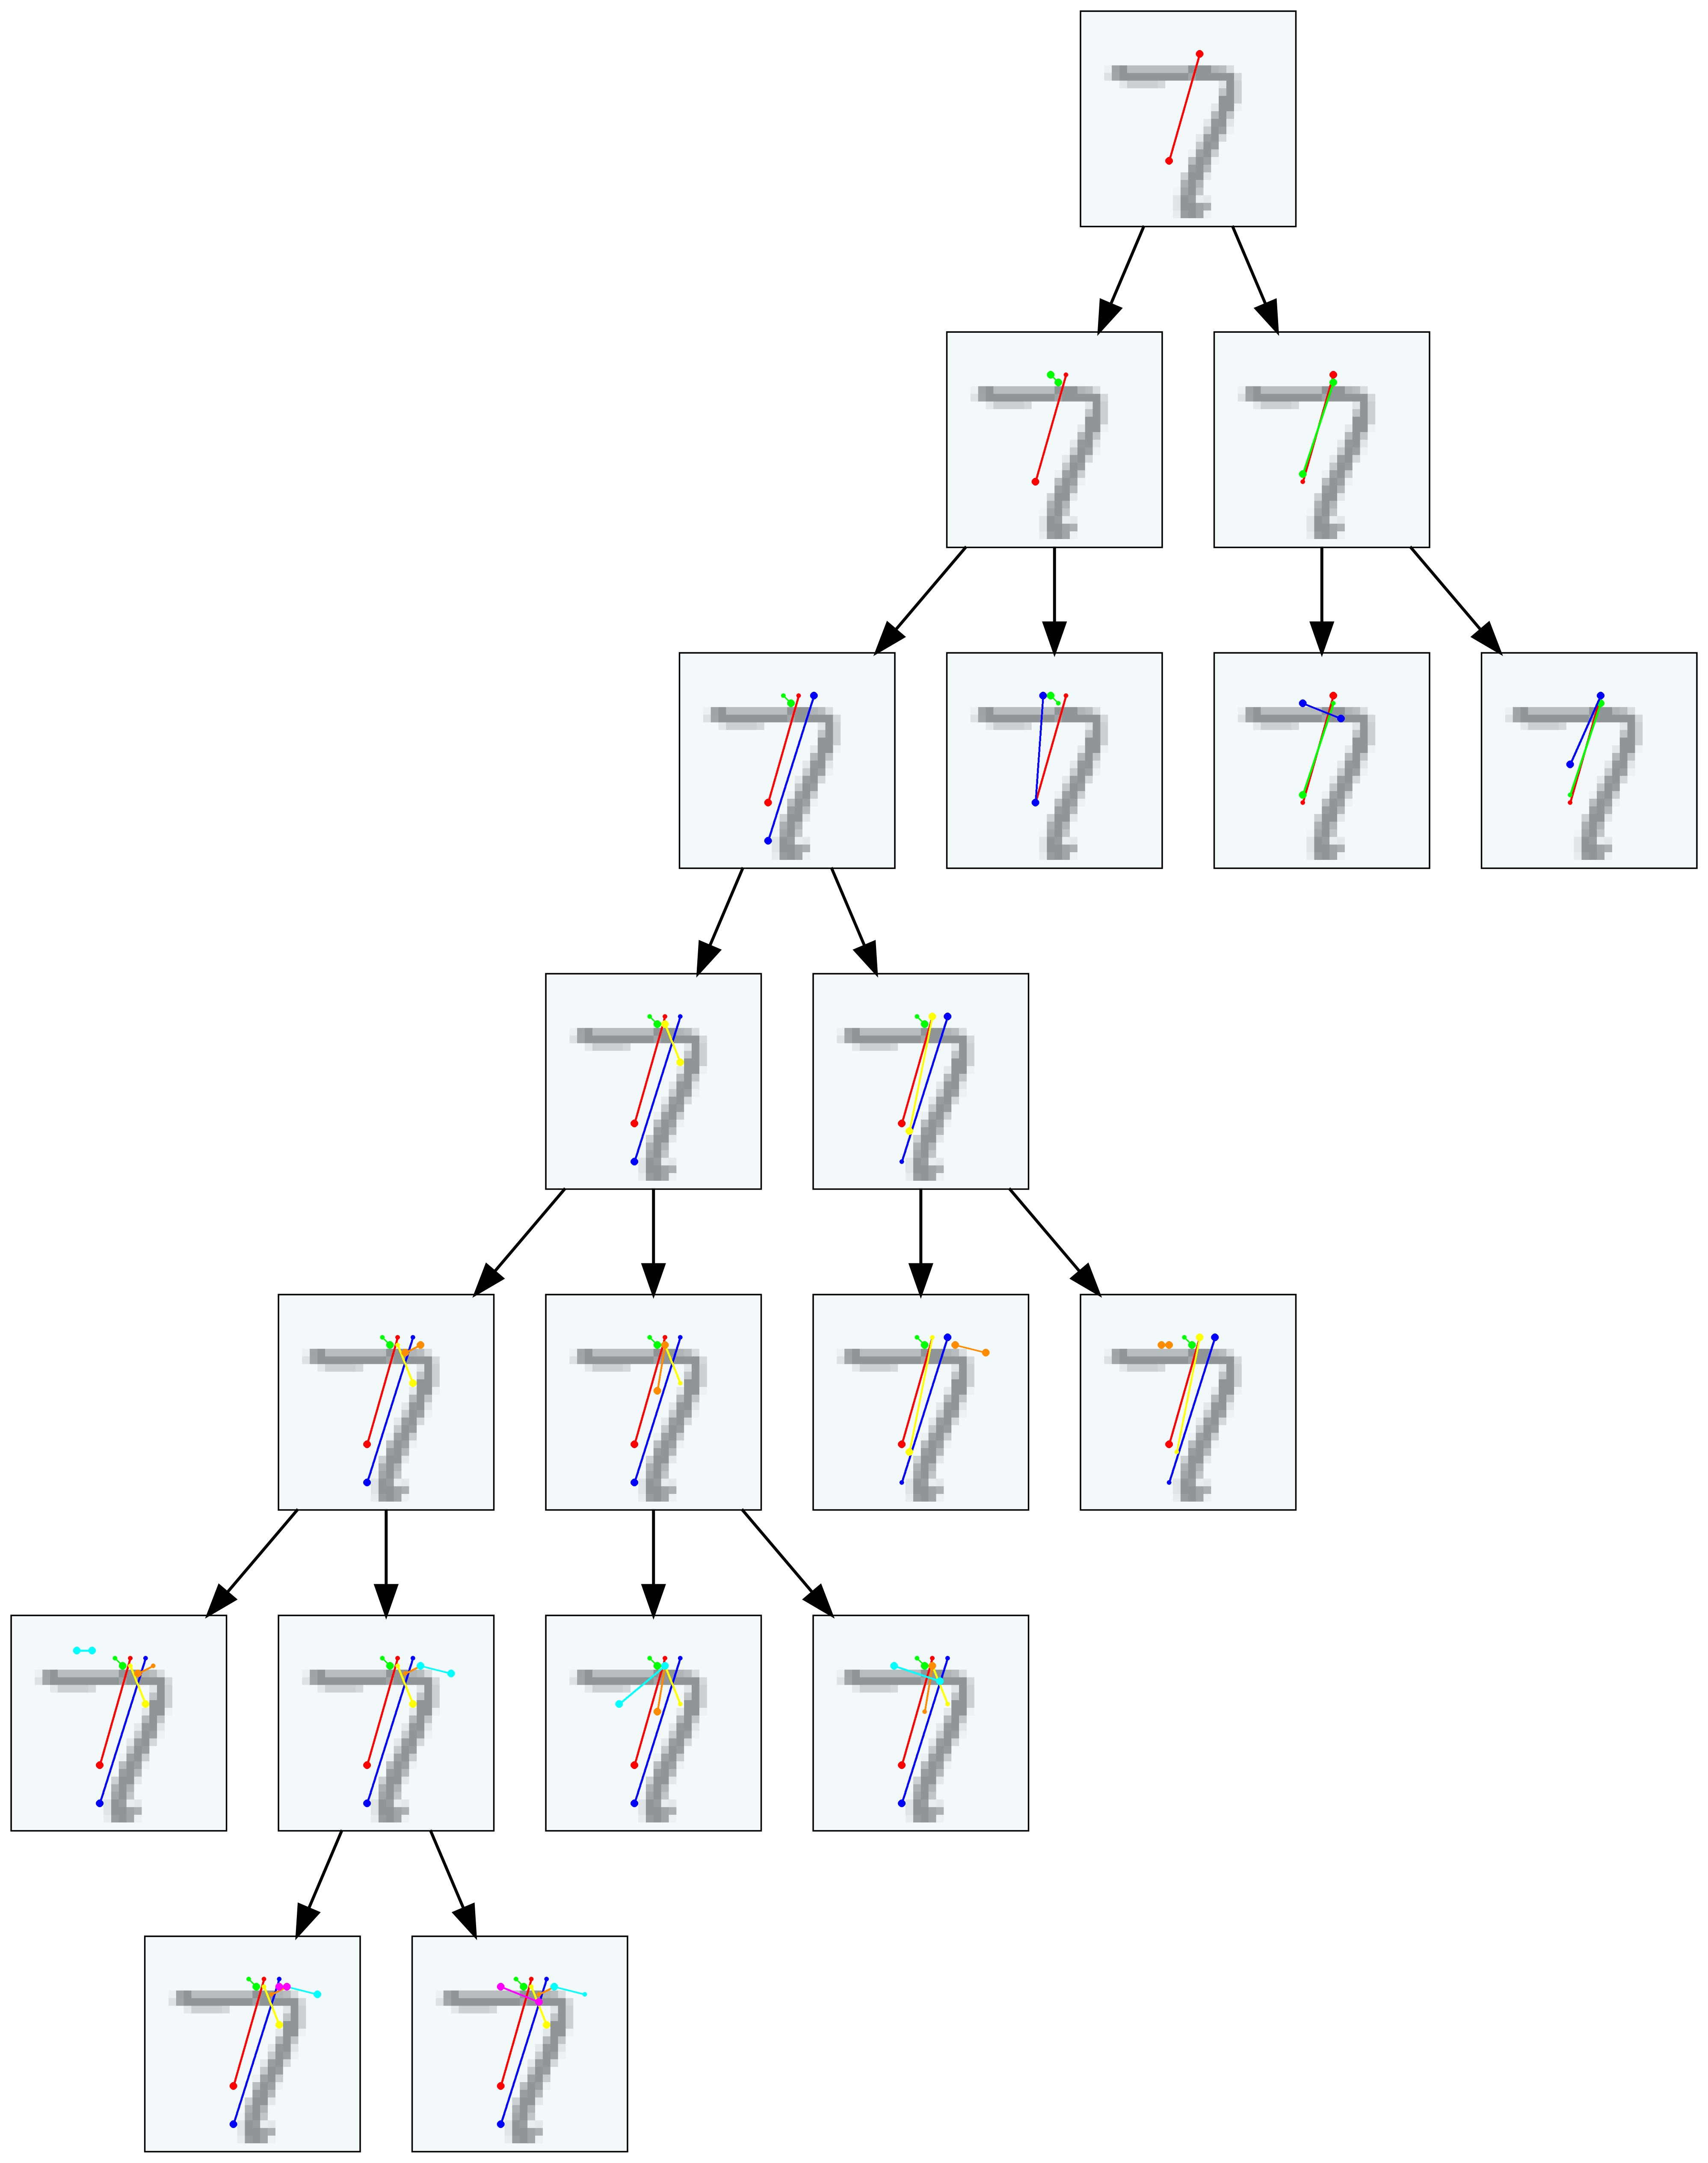


MNIST – Interpretability
Formal XAI via Syntax-Guided Synthesis Katrine Bjørner, Filip Cano

Slide 20
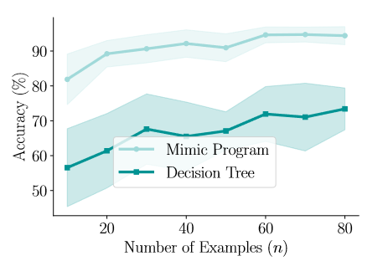
MNIST – Global Accuracy
Formal XAI via Syntax-Guided Synthesis Katrine Bjørner, Filip Cano

Slide 21
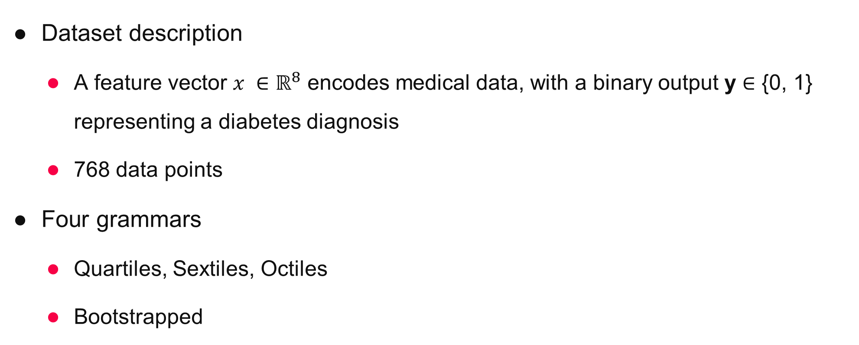
Pima – Grammar
Formal XAI via Syntax-Guided Synthesis Katrine Bjørner, Filip Cano
Dataset description
A feature vector $x ∈ℝ^{8}$ encodes medical data, with a binary output y ∈ {0, 1} representing a diabetes diagnosis
768 data points
Four grammars
Quartiles, Sextiles, Octiles
Bootstrapped

Slide 22

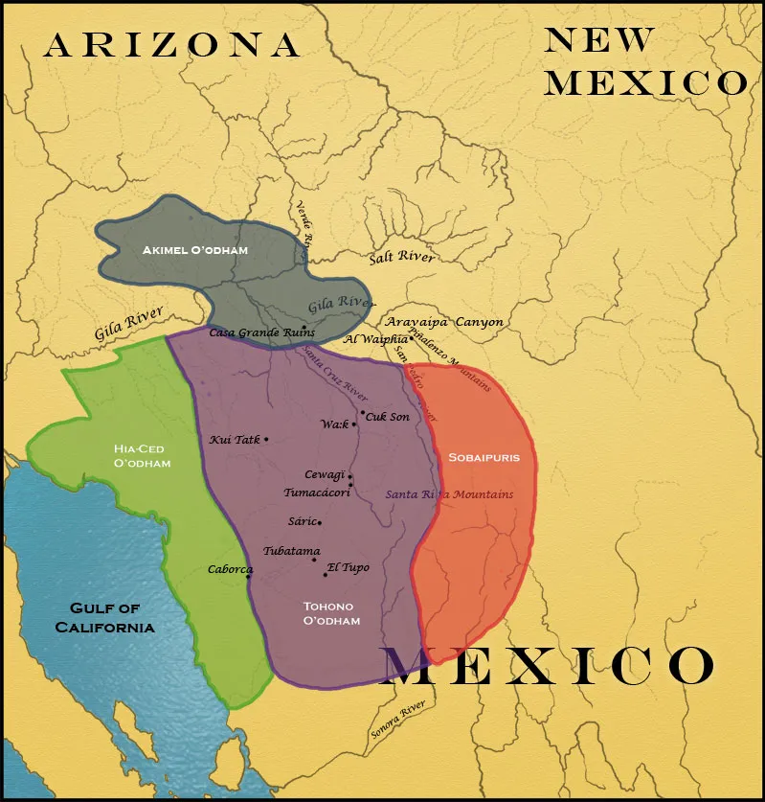
History Time: Pima Indians
Formal XAI via Syntax-Guided Synthesis Katrine Bjørner, Filip Cano
Pima is used to name the Akimel O‘odham nation
📖 When Spanish settlers first contacted the nation, they just called them by the word the natives were most saying, which in fact means
“I don‘t know“
📖 Gil-Osle, JP, Cabeza de Vaca’s Primahiatu Pidgin, Journal of the Southwest (Vol. 6, No.1, pp. 253-269), 2018

Slide 23
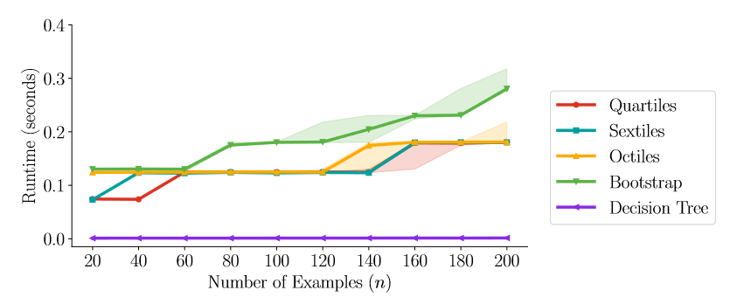
Pima – Synthesis Times
Formal XAI via Syntax-Guided Synthesis Katrine Bjørner, Filip Cano

Slide 24
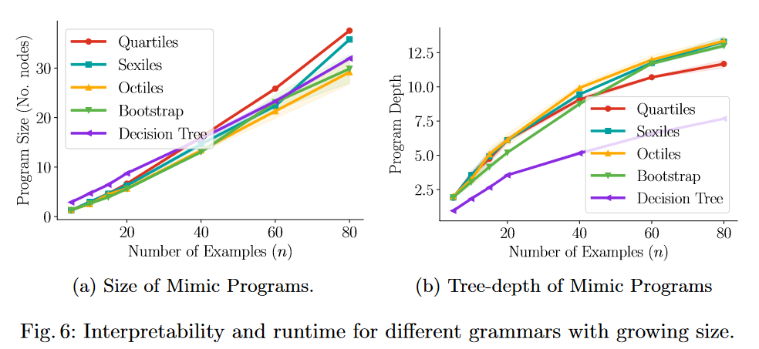
Pima – Interpretability
Formal XAI via Syntax-Guided Synthesis Katrine Bjørner, Filip Cano
For all grammars
the size of the mimic program grows linearly and the depth of the program grows logarithmically
Decision trees are more “balanced”
i.e. significantly shallower while maintaining size
Similar to MNIST programs

Slide 25
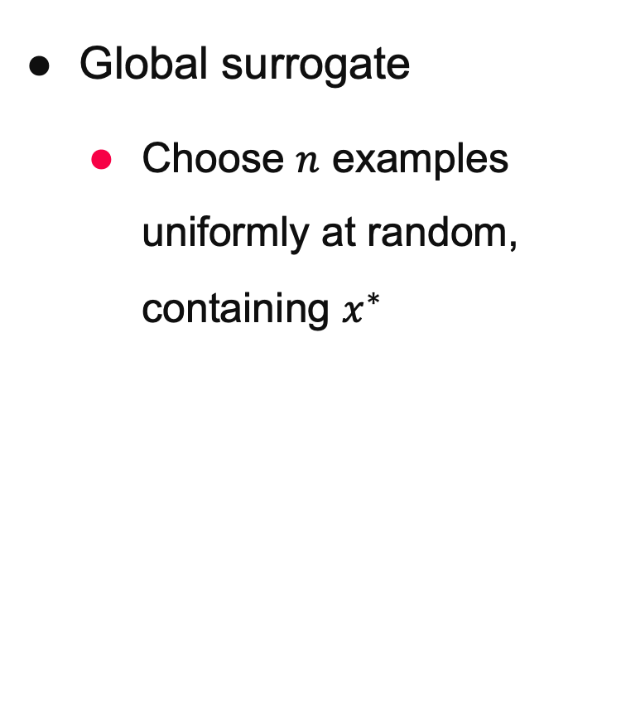
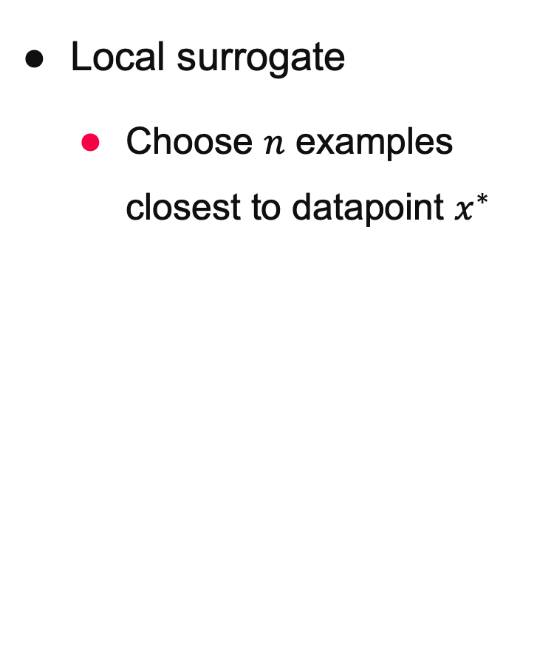
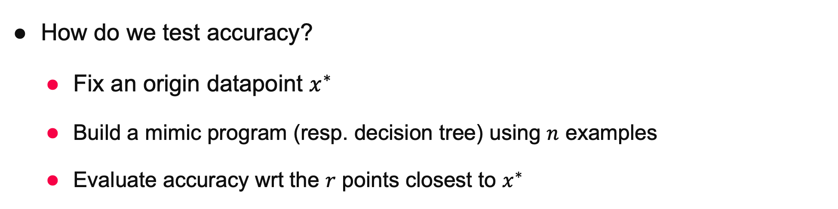
Pima – Global vs. Local Accuracy
Formal XAI via Syntax-Guided Synthesis Katrine Bjørner, Filip Cano
How do we test accuracy?
Fix an origin datapoint $x^{∗}$
Build a mimic program (resp. decision tree) using $n$ examples
Evaluate accuracy wrt the $r$ points closest to $x^{∗}$
Local surrogate
Choose $n$ examples closest to datapoint $x^{∗}$
Global surrogate
Choose $n$ examples uniformly at random, containing $x^{∗}$

Slide 26
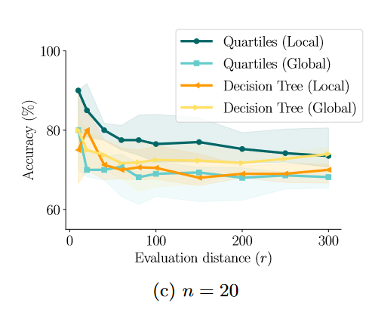
Pima – Global vs. Local Accuracy
Formal XAI via Syntax-Guided Synthesis Katrine Bjørner, Filip Cano

Slide 27
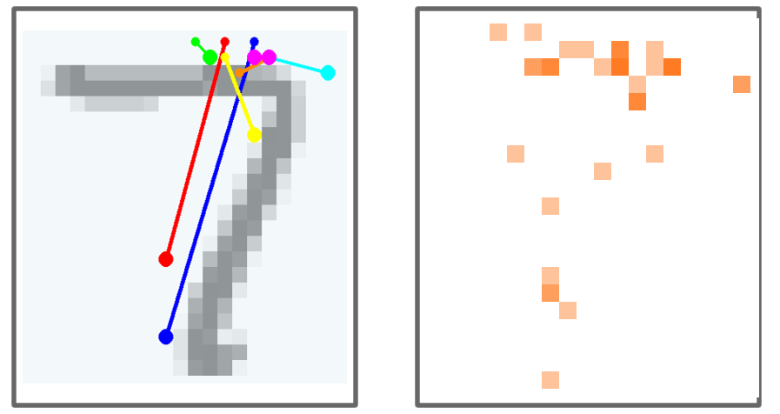
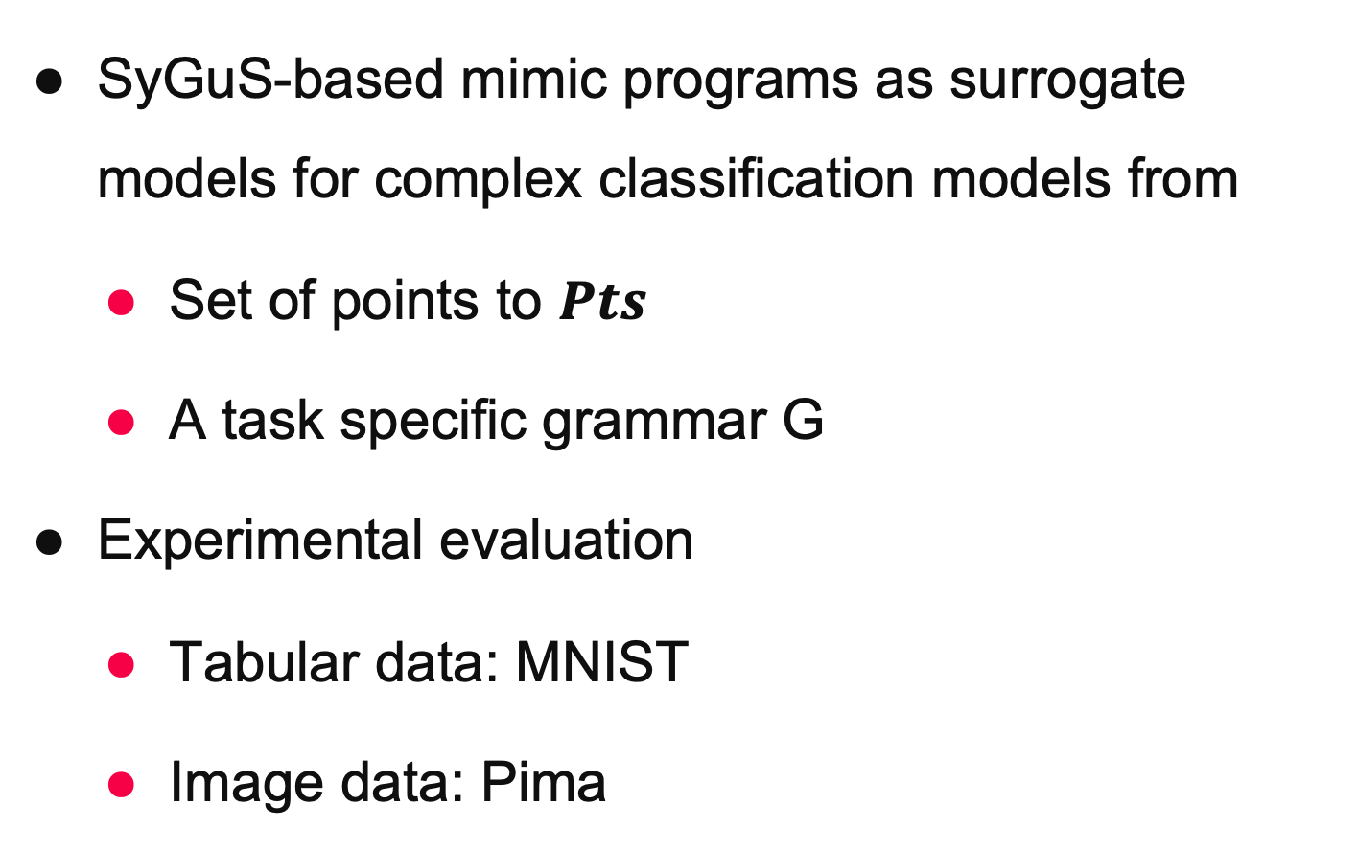
Contributions
Formal XAI via Syntax-Guided Synthesis Katrine Bjørner, Filip Cano
SyGuS-based mimic programs as surrogate models for complex classification models from
Set of points to $Pts$
A task specific grammar G
Experimental evaluation
Tabular data: MNIST
Image data: Pima
This work has received funding from the European Union’s Horizon 2020 research and innovation programme under grant agreement Nº 956123 - FOCETA.

